Slide 1
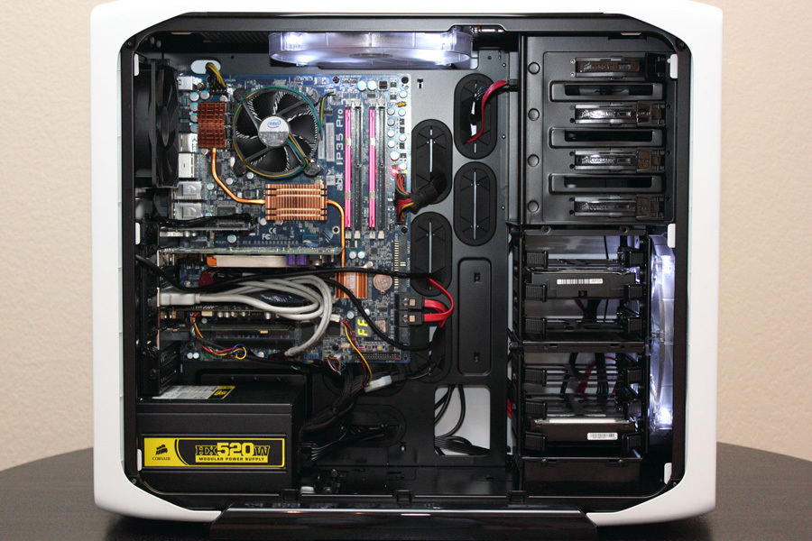
Cooling Fan
Memory Board
DVD Drive
USB Port
Monitor port
Ethernet port
Audio Port
Power Supply
Hard drive
Mother Drive

Slide 2
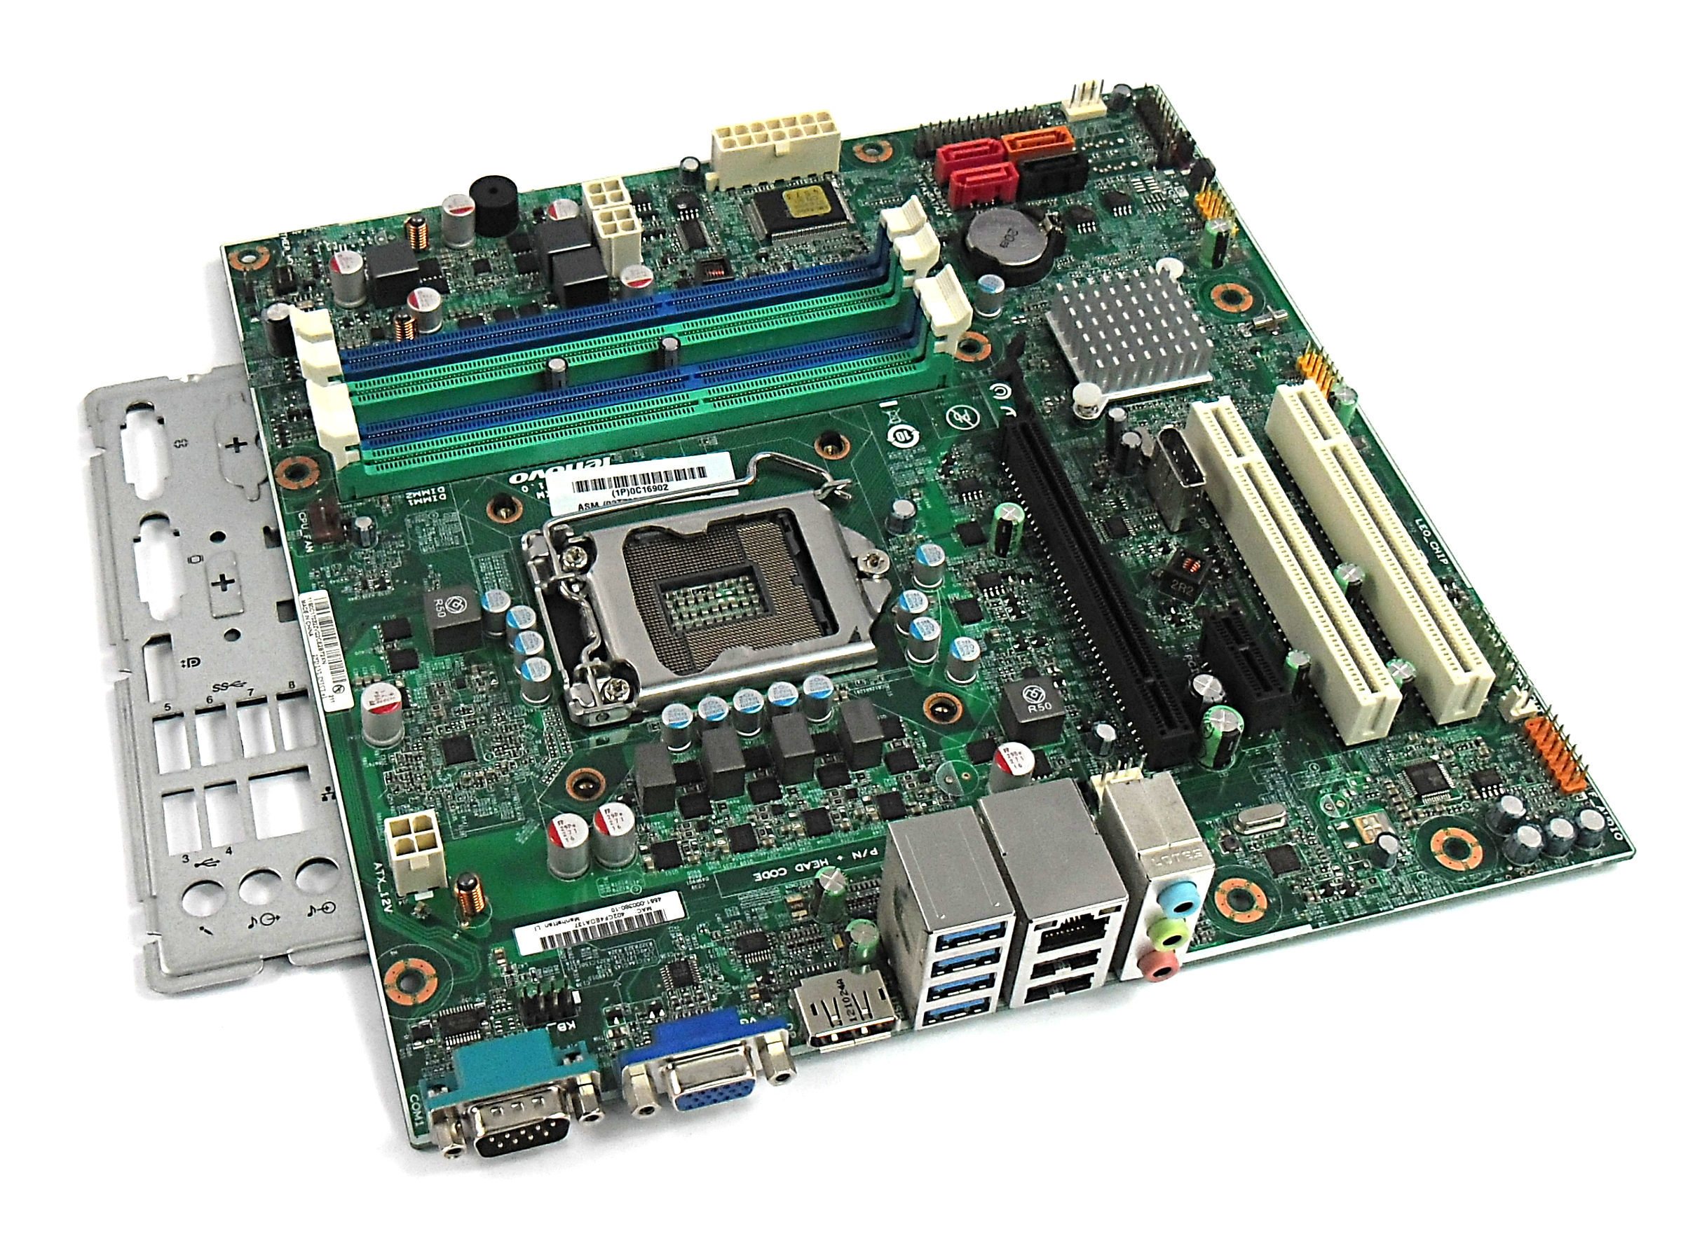
Wi-Fi Processor
RAM Storage
SATA Lines
Graphics Card
CPU and Fan
Sound Processor

